Slide 1
COVID-19 Diet

Slide 2
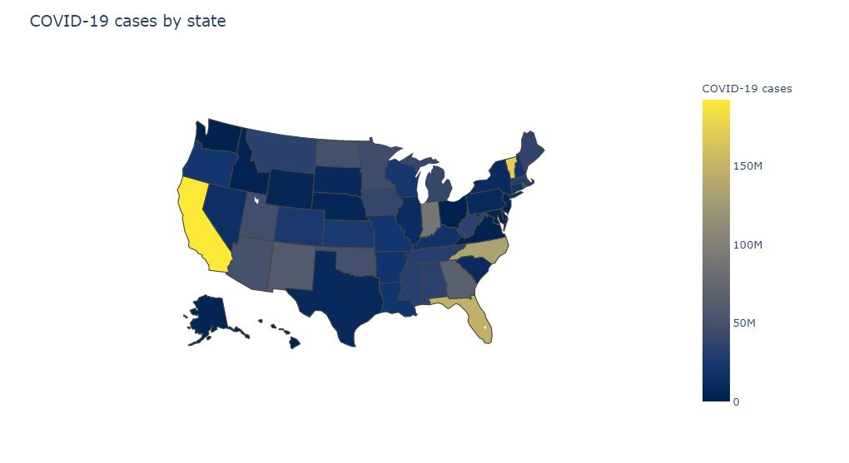
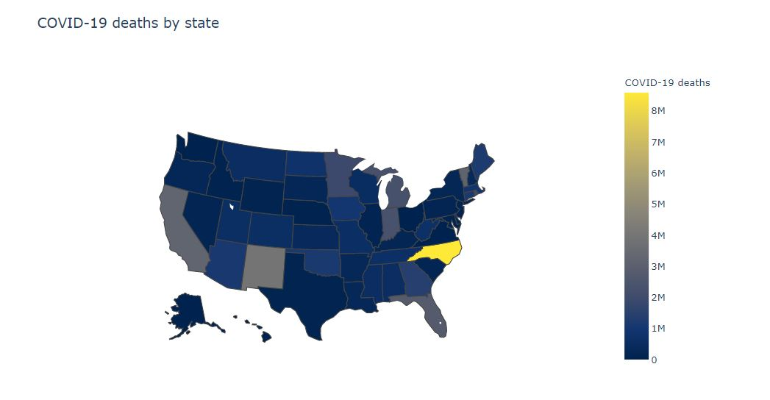
COVID-19 cases and death in US
Even the number of the cases in CA is more, the death numbers
Are less !

Slide 3
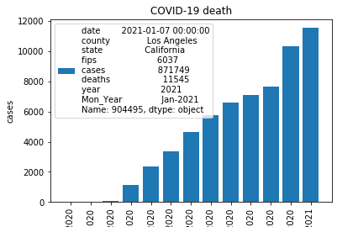
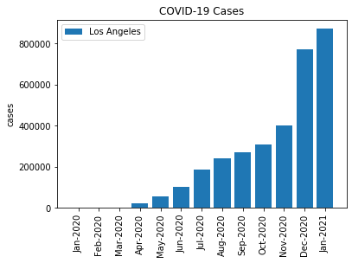
COVID-19 cases in CA
The plots shows that LA county has the highest cases and death cases

Slide 4
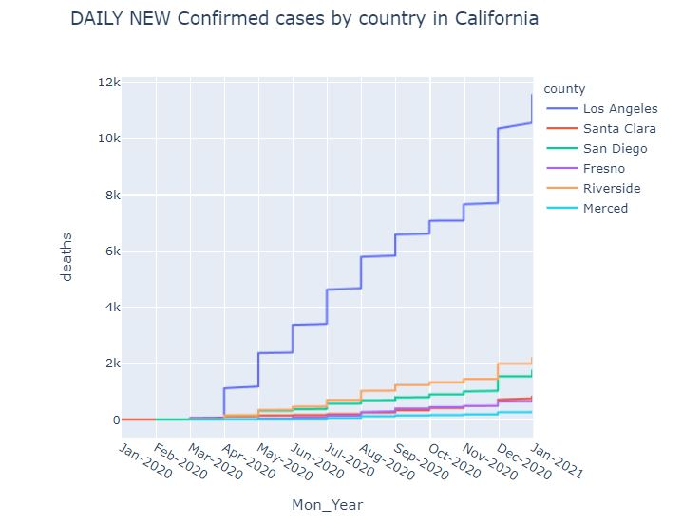
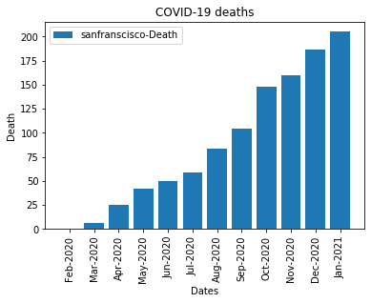
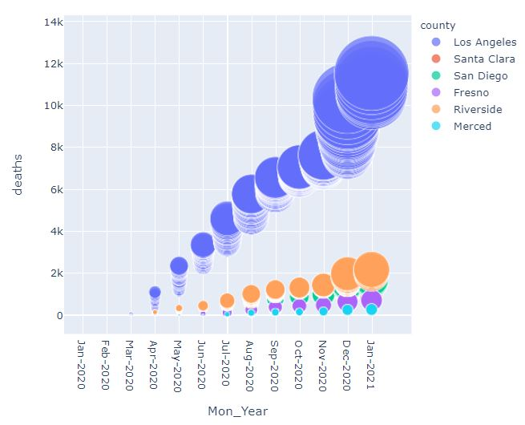
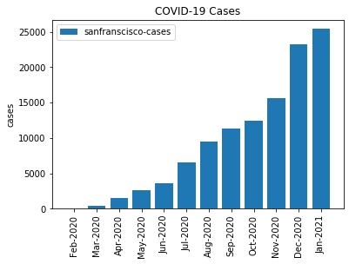
The COVID-19-cases with different counties and relation with death rates
The plots shows that the selected counties in CA, as the dates increase with time from Jan 2020-2021, the number of the death increased and the size of the circles represent the number of the cases which confirms that as the number of cases increase, the number of death increase for all the counties in CA.
Significant increase in # cases for all the presented counties in CA in NOV can be seen.

Slide 5
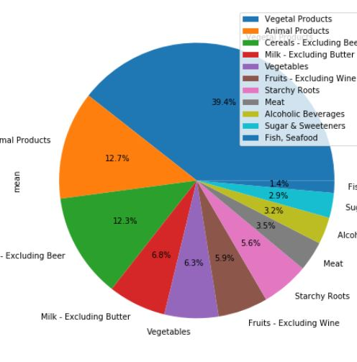
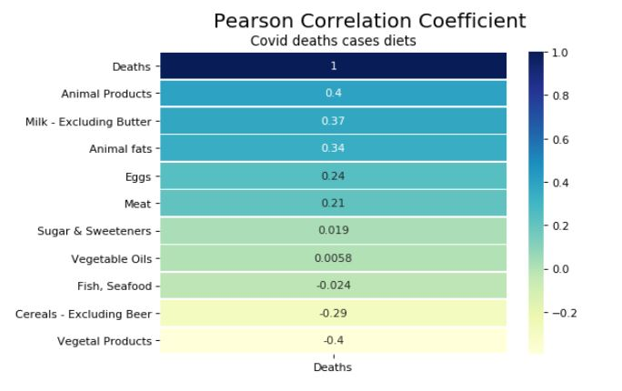
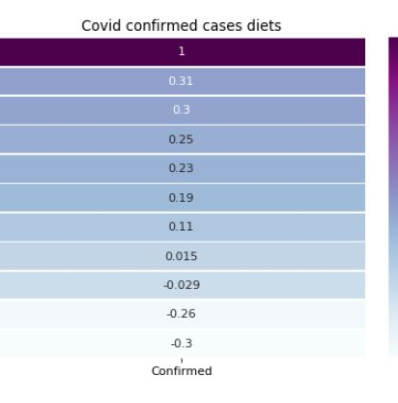
COVID-19 VS Diet
The Pearson correlation coefficient for both the confirmed and death cases showed the highest for Animal products and Milk for the whole countries around the world.
Also the pie chart showed that people consumed more vegetable products during covid-19 situation than the animal products.
The confirmed and death individuals had the same diet habit.

